Slide 1
Software Development Automated Testing

Slide 2
Session Summary
What are the benefits of automating software tests?
Unit Testing 101 + Copilot
Integration Testing 101 + Copilot
End-to-End Testing 101 + Copilot

Slide 3
What issue are we trying to solve?

Slide 4
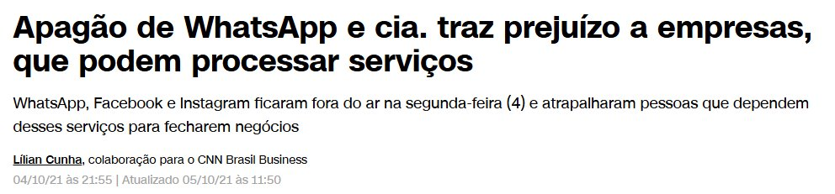

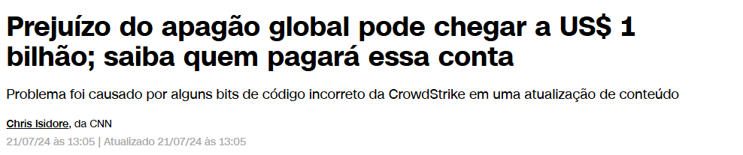
Software Errors can cause a lot of issues

Slide 5
Issues that Software errors can cause
Software errors cost you valuable time.
Time spent fixing software issues could be better used developing new features that boost company revenue or reduce expenses.
​
Software errors damage your credibility
Customers, partners, and even internal teams may begin to question the dependability of your product.
Once trust is lost, regaining it can be both difficult and costly.
​
Software errors cause a loss of control
Production bugs can escalate into urgent problems, dominating engineering efforts.
Rather than focusing on strategic goals, teams find themselves constantly reacting to crises.
​​​​

Slide 6
Issues that Software errors can cause
Software with bugs can cause a loss of focus
Frequent disruptions from bug reports and urgent issues can interrupt long-term planning.
Product teams may lose track of innovation and the evolving needs of customers.
​
Software with bugs can lead to lost opportunities
A bug that delays a product launch might result in missing key seasonal markets or investor deadlines.
Malfunctioning features or failed transactions can result in lost business.
​
Software with bugs can cause loss of compliance
Failure to comply with industry standards or legal regulations can lead to penalties.
This is particularly important in fields such as healthcare, finance, and government sectors.
​

Slide 7
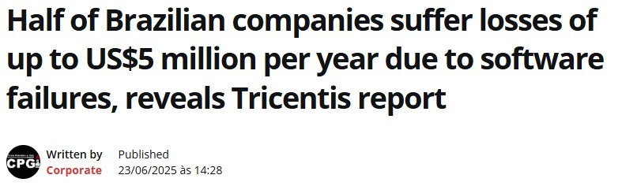
The impact of Software Errors in Brazil
Source: https://www.tricentis.com/resources/quality-transformation-report
Source: https://en.clickpetroleoegas.com.br/Half-of-Brazilian-companies-suffer-losses-of-up-to-US%245-million-per-year-due-to-software-failures--reveals-Tricentis-report/

Slide 8
The impact of Software Errors in Brazil
Risk of interruptions worries Brazilian and Latin American companies
Still according to the survey:
56% of Brazilian companies said they were exposed to software outages every year.
In Latin America, this number rises to 68%.
Smaller companies (between 150 and 249 employees) are even more vulnerable, with 88% reporting this concern.
In the industrial sector, 73% of organizations in the region also declared themselves exposed to this risk.
Pressure for speed and internal challenges impact quality
Among the causes for increased risks, the following stand out:
Pressure to speed up deliveries (37%).
Communication failures between leaders and testers (35%).
Frustration with early results of using AI (34%).
In the case of Brazil, 36% of companies stated that the search for speed is one of the biggest barriers faced in the development process.

Slide 9
I understood the issues, how can I have a Software with zero errors?
You don't
But you can reduce its impact

Slide 10
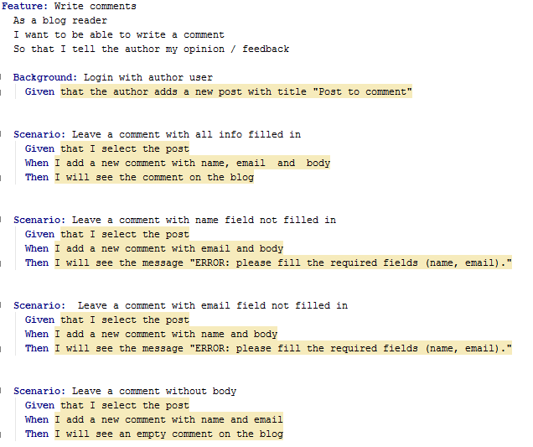
The Objectives of Software Testing
Verification & Validation
Confirms the software meets both technical specs and user expectations.
E2E Test using BDD https://cucumber.io/docs/bdd/

Slide 11
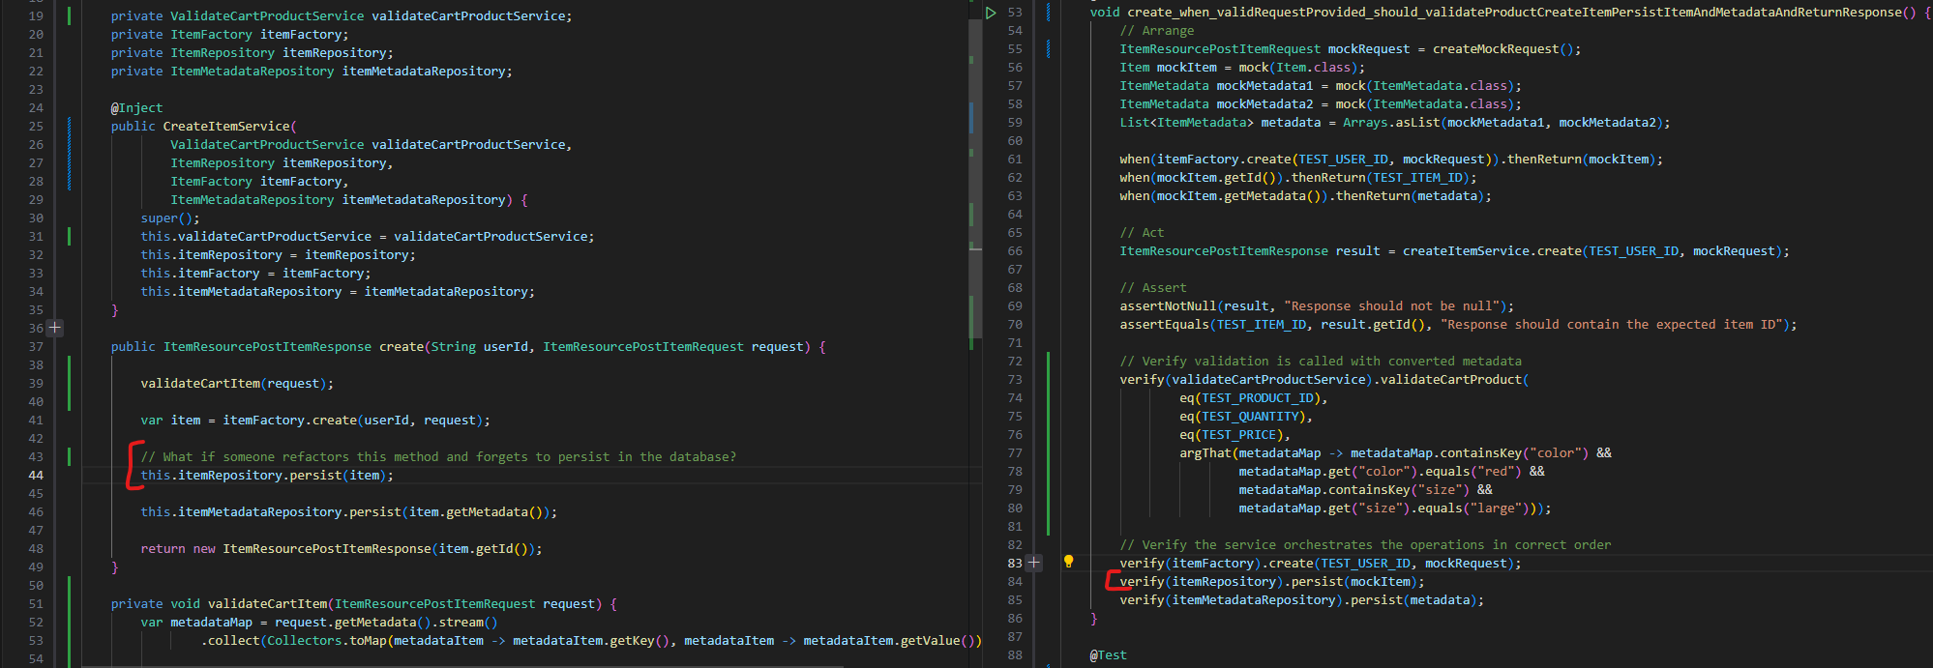
The Objectives of Software Testing
Defect Detection
Identifies bugs early to reduce cost and risk.

Slide 12
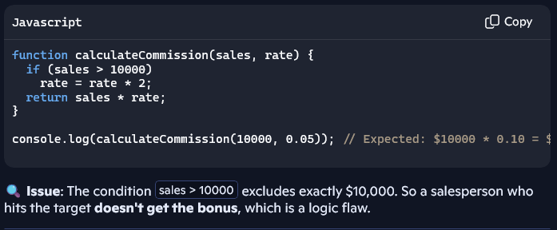
The Objectives of Software Testing
Risk Mitigation
Prevents failures that could lead to financial, legal, or reputational damage.

Slide 13
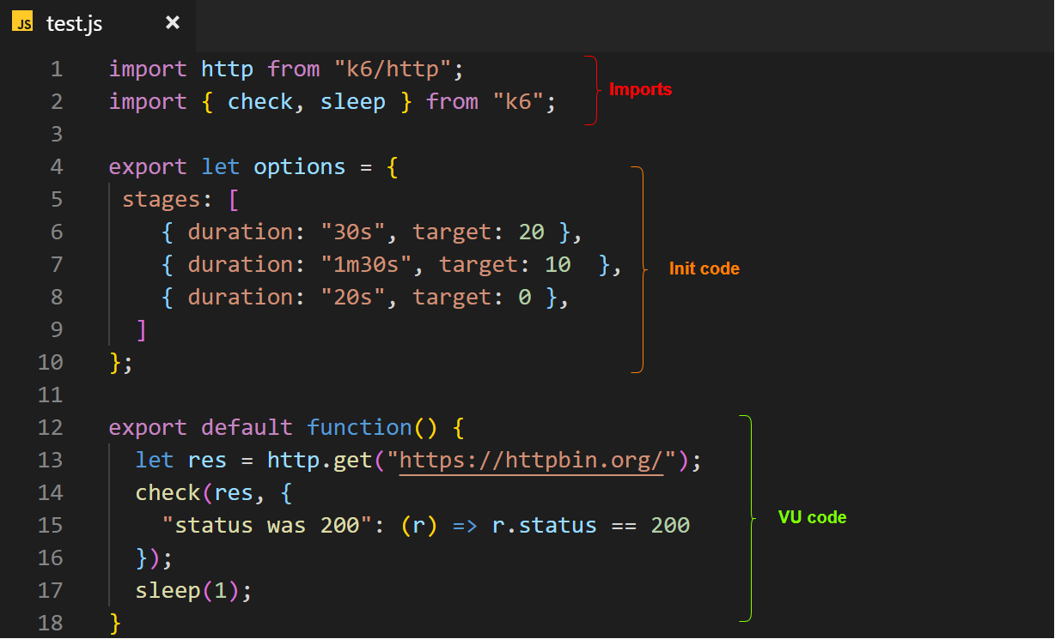
The Objectives of Software Testing
Quality Assurance
Ensures performance, reliability, usability, and security.
Load Testing using k6 https://k6.io/

Slide 14
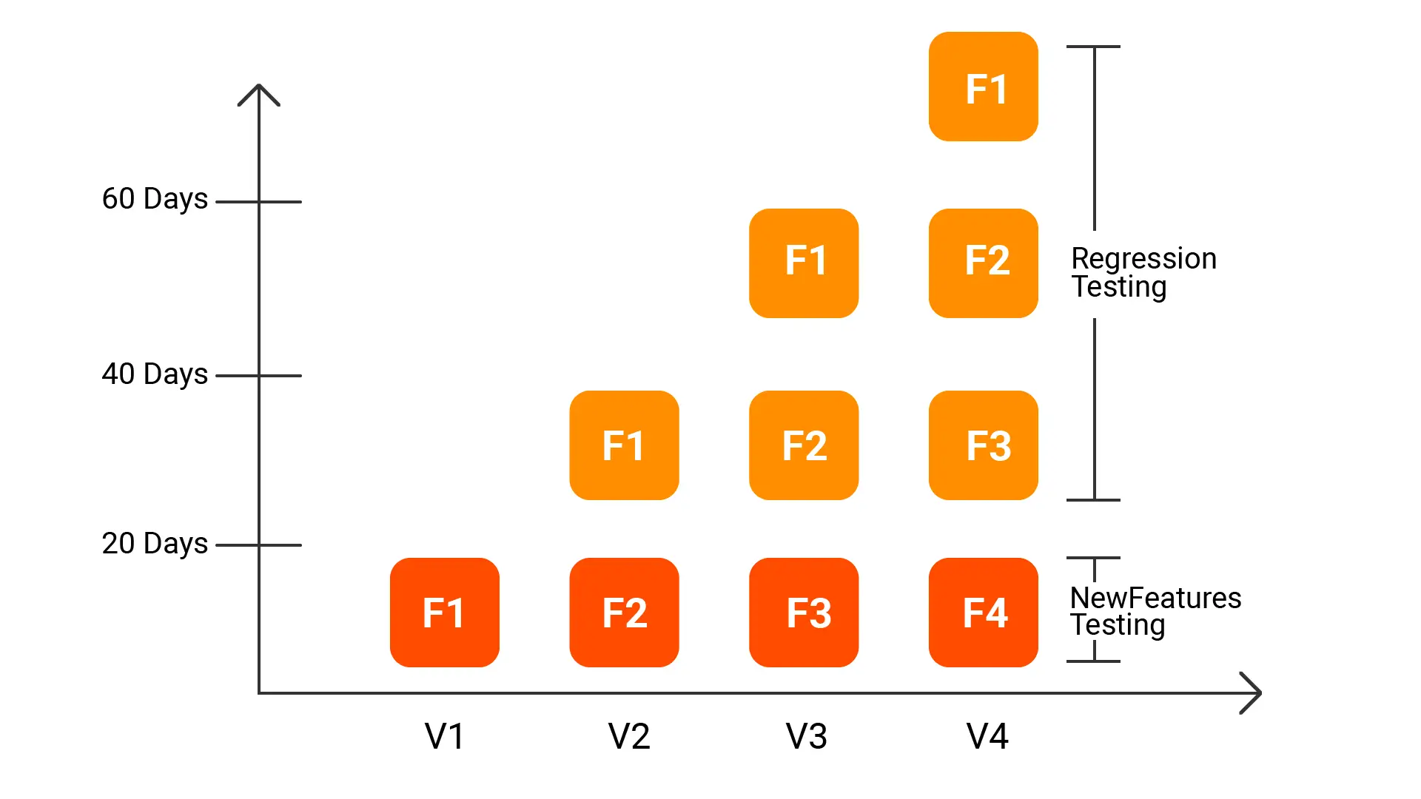
The Objectives of Software Testing
Regression Prevention
Ensures new changes don’t break existing functionality.

Slide 15
The Objectives of Software Testing
Learning & Improvement
Helps teams improve coding practices and system design.
Code that is poorly written makes testing quite challenging.
Additionally, the requirement to write tests encourages you to think more carefully about the solution you choose.
Creating tests can help identify issues that might go unnoticed when focusing solely on writing the production code.

Slide 16
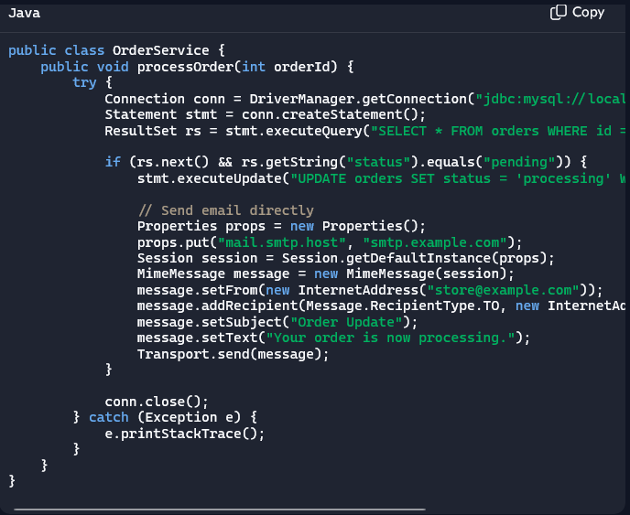
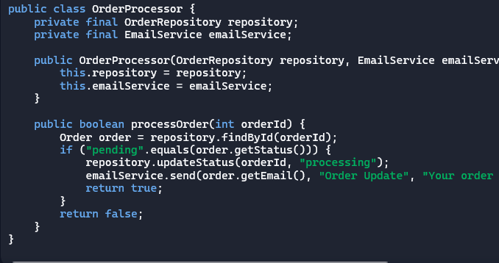
The Objectives of Software Testing
Learning & Improvement
Helps teams improve coding practices and system design.

Slide 17
When should I test my Software?
Testing actually begins long before coding starts; it starts during the requirements gathering phase.
​
Prior to writing any code, it is crucial to plan how the feature will be tested.
​
Testing should be incorporated throughout all phases of the software development lifecycle, from the IDE environment through to production deployment.
Identifying problems early is essential.

Slide 18
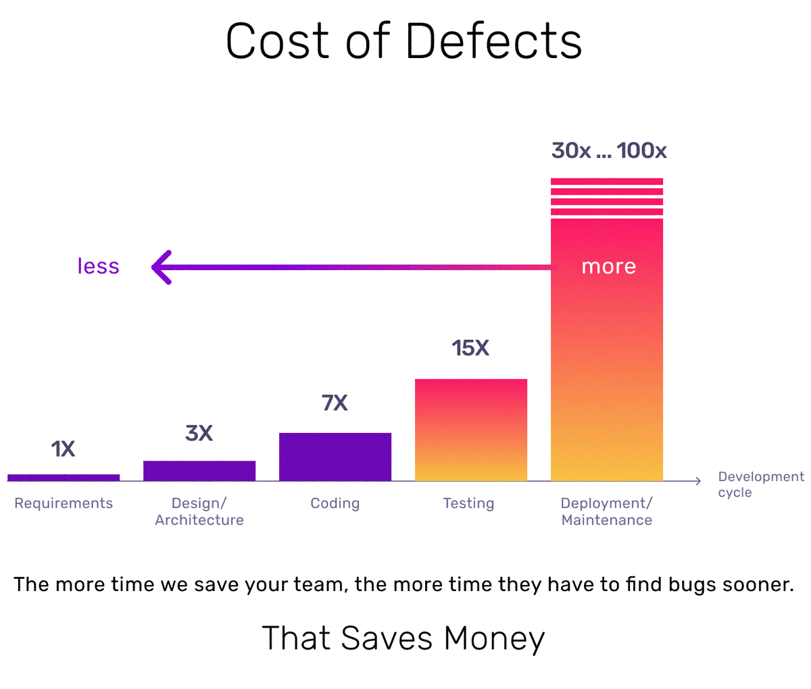
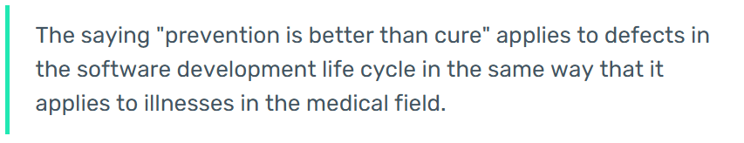
The Cost of Finding Bugs Later
The sooner you identify bugs in your software, the lower the cost of fixing them.
During the initial phases such as requirements gathering, design, and coding, errors primarily result in lost time.
However, if bugs are discovered in later stages, they not only consume more time but can also cause significant financial losses.

Slide 19
The Cost of Finding Bugs Later – A practical example
You're a developer, with a task do add new functionality to an existing code.
The app you are working on, is an App that generate receipts and sends them by email to the users.
The email sent, contains details of the receipt and a PDF file with the full receipt.
The task you have in hand is to optimize this code to run the email sending process in parallel to speed up the process.
But you make a mistake, you change the code to send the email in parallel but forgot to attach the PDF file.

Slide 20
The Cost of Finding Bugs Later – A practical example
Suppose there is no automated testing for this scenario, and the error goes unnoticed during manual testing.
You would only become aware of the problem once customers start reporting it, which could result in:
Customers losing confidence in your system, potentially missing sales due to missing receipts or encountering tax complications.
Interrupting your current tasks to address the bug, causing a chain reaction of delays in delivery.
Spending time debugging to identify the source of the error.
Once identified, dedicating time to fix the problem.
Finally, repeating the entire development workflow, including Pull Requests, deployments, and approvals.

Slide 21
The Cost of Finding Bugs Later – A practical example
After all of that, you fix the bug.
But the worst part is...
There's no guarantee that this problem will not happen again.

Slide 22
Manual Software Testing

Slide 23
Manual Testing Software Testing
Manual testing is when a human tester checks a software application without using automation tools. The tester follows test cases or explores the system freely to find bugs, verify features, and ensure the software behaves correctly.
Strengths
Detects visual and user experience issues better than machines
Great for exploratory and ad-hoc testing
Flexible and easy to adjust during testing
No need for complex tools or scripts
Weaknesses
Time-consuming for repetitive tasks
Prone to human error
Hard to scale for large projects
Tests must be repeated manually every time

Slide 24
Manual Testing Software Testing
Machines offer a more cost-effective and quicker alternative to human labor.
Consider the scenario where every line of code in your software must be retested with each new version.
How much time would this process require?
How many individuals would need to participate?
What would be the expense for the company to have employees performing this task instead of focusing on activities that create value?

Slide 25
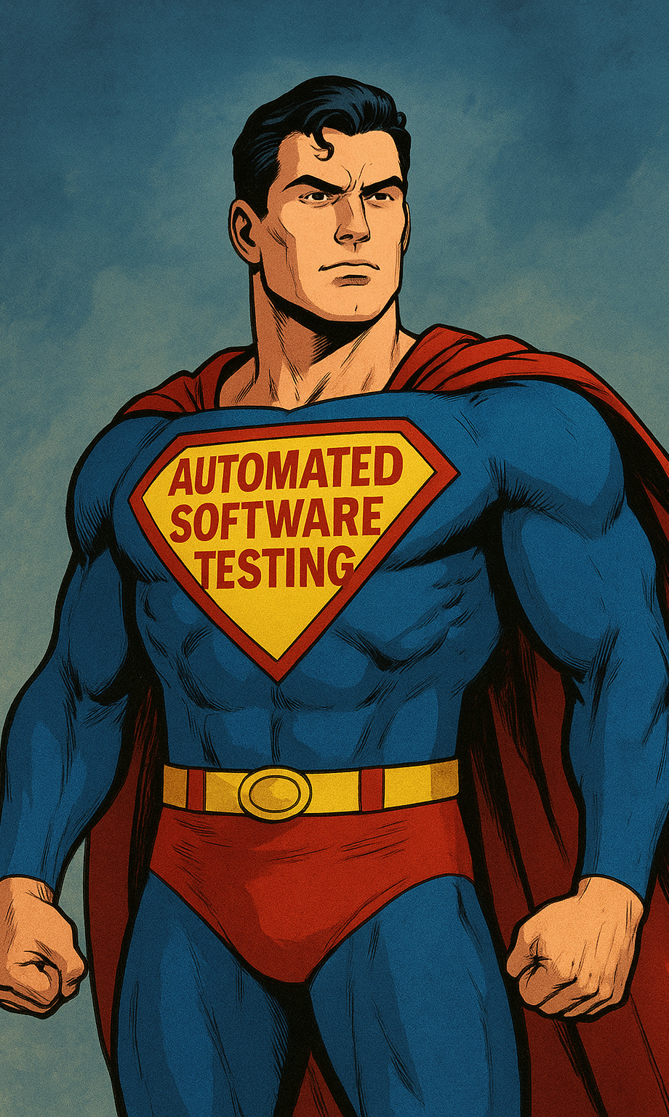
Here comes Automated Software Testing

Slide 26
But wait, control your expectations

Slide 27
There are no Software with Zero amount of Bugs
Don’t matter if you are an Open Source Software, a small startup or a big enterprise.
Don’t matter if you are creating an OS kernel, a web application or a video game.
Don’t matter if you spend a lot of time testing your software.
Don’t matter if you have the best developers in the world.
Software is created by people and people make mistakes.

Slide 28
Only large projects need testing.
This is a myth. Small projects benefit just as much from testing. Early bugs are cheaper to fix, and tests help maintain code quality as the project grows. Testing isn’t about size—it’s about responsibility. A small script being part of a larger system, can bring everything down

Slide 29
Software Testing Is Not Easy
Testing requires analytical thinking, domain knowledge, and creativity.
It’s not just clicking buttons—it’s designing scenarios, anticipating edge cases, and understanding how systems behave under stress.
You have to think before writing your production code of how you’re going to test it.
Sometimes, you will need to make your code more complex or verbose to be able to test it.

Slide 30
Software Testing Consumes Time
Most of the time, you will spend more time writing tests than writing production code.
Writing automated tests takes time.
Yes, it does—but it saves even more time down the road.
Skipping testing leads to costly bugs, frustrated users, and painful debugging.
Testing is an upfront investment that pays off in stability and speed.

Slide 31

Writing Tests Is the QA Team’s Job
Not true.
Developers should write unit tests as part of their workflow.
QA focuses on broader testing strategies like integration, performance, and exploratory testing.
Testing is a shared responsibility.

Slide 32
Code Coverage Equals Quality
High coverage can be misleading. You might cover every line but miss critical logic paths.
Quality comes from meaningful tests—ones that assert correct behavior, not just touch code.
Mutation tests can help you evaluate if your tests have issues and are not properly testing the code.

Slide 33
It’s All About Culture

Slide 34
It’s All About Culture
Is impossible to have the benefits of Automated Testing in an environment where most people are not onboard.
From the developer, to the QA, to the Product Owners, Designers, Managers, Sellers and Executives.
Everyone should understand the value of Automated Testing and work together to achieve the best results.
Most companies fail or not even try to implement Automated Testing because of this.
“Tests take a lot of time to do; we need to deliver things fast”
“We don’t have the right skills; they won’t know how to do it”
“Our customers are not paying is for tests, they need features”
“My developers don’t want to write tests”

Slide 35
So, what exactly I should expect from Automated Software Testing?

Slide 36
So why should I do automated testing?
Automated Software Testing offers the following benefits:
Reduces the number of bugs to a minimum.
Ensures that the same bug does not reoccur.
Simplifies the process of locating bugs.
Minimizes the impact of any bugs that do occur.
Frees up time for people to focus on tasks that add real value, rather than repeatedly retesting.
Increases confidence in the development process, making it easier to implement changes without fear of causing failures, facilitating onboarding of new team members to work on existing code.
Indirectly improves overall code quality.

Slide 37
Types of Automated Software Testing

Slide 38
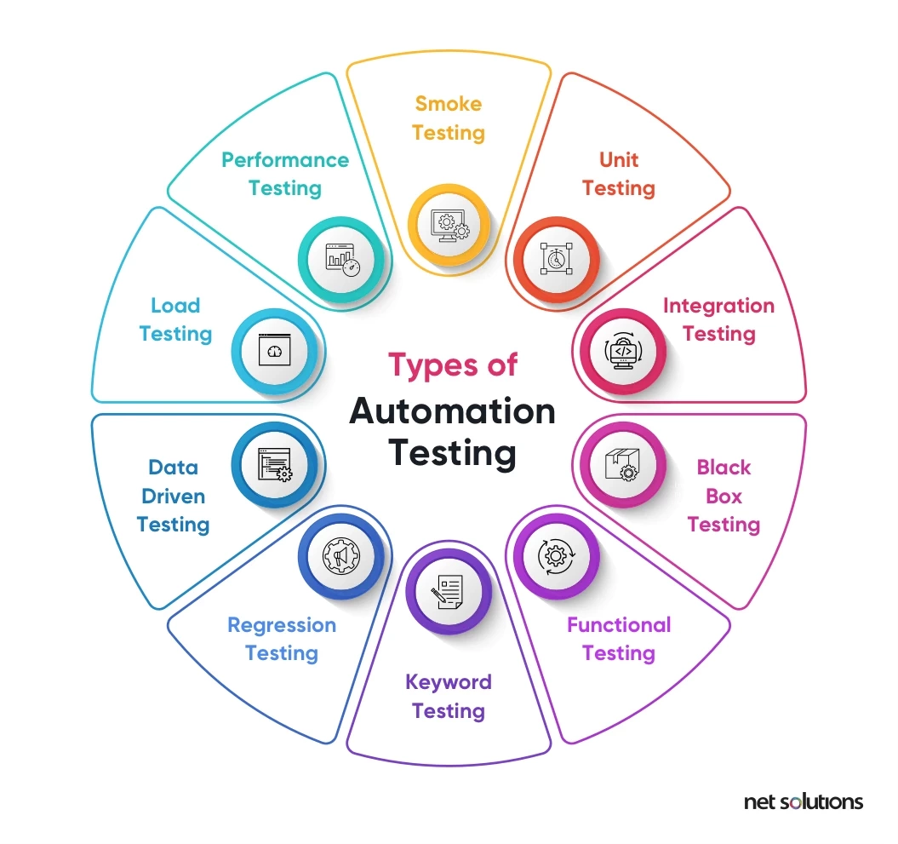
Types of Automated Software Testing
There are many types of automated software testing.
Every team should decide based on their current context what makes sense in their development process.
Different types of tests have different purposes, costs, people who should be engaged, coverage, risks, frequency, required tools, required knowledge, depth and learning curve.

Slide 39
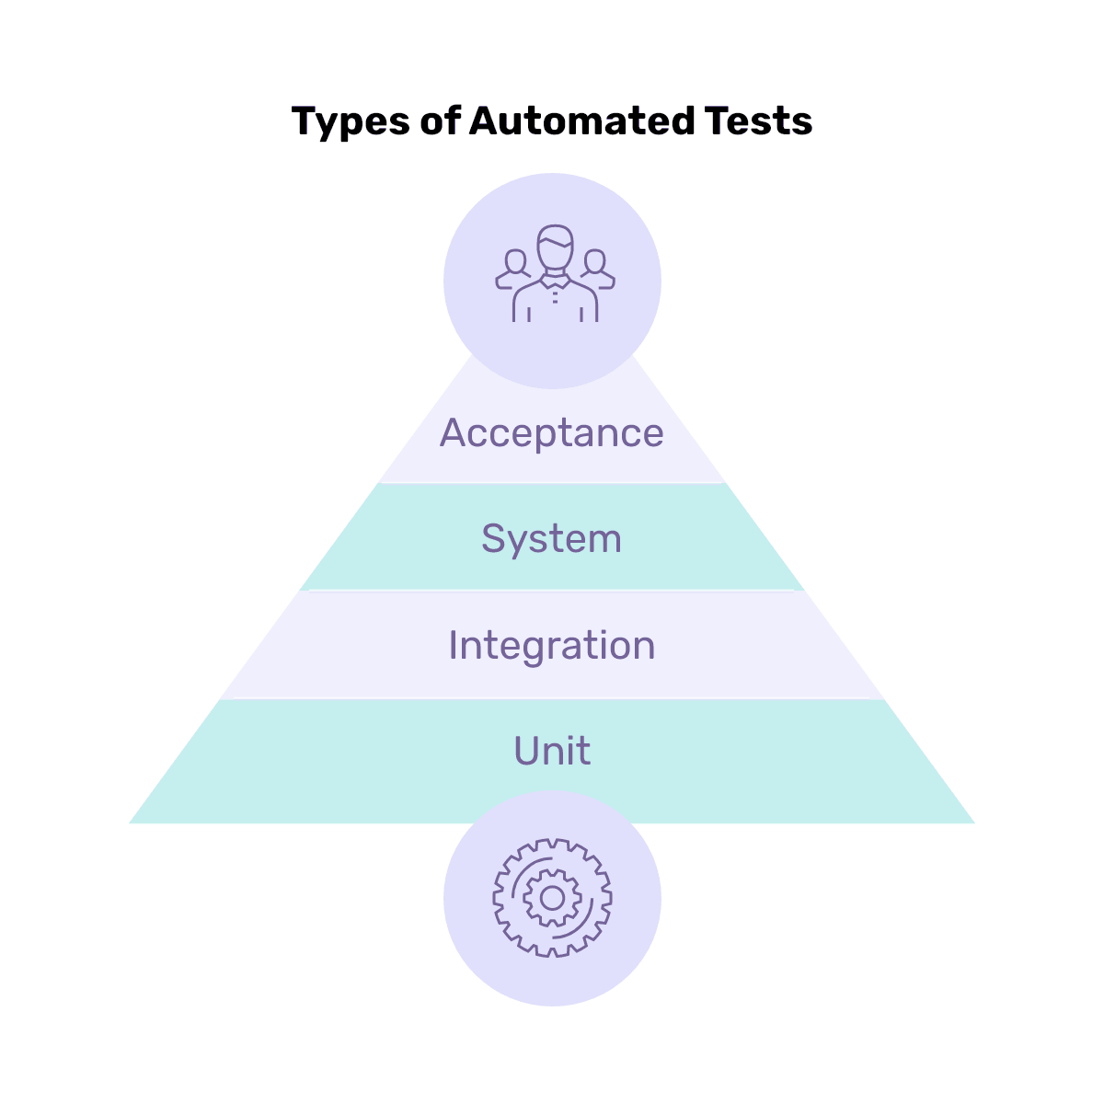
Most common types of Automated Tests
In software development, certain types of tests tend to be more prevalent, primarily because they provide value across a wide range of scenarios.
These tests are often visualised as a pyramid, with the largest number of tests at the base and fewer tests as you move toward the top.
At the lower levels, the focus is on the question, “Are we building the system, right?”
Whereas at the higher levels, the emphasis shifts to, “Are we building the right system?”
Both perspectives complement each other.

Slide 40
Most common types of Automated Tests
Unit Testing
Tests individual components or functions in isolation. Typically written and run by developers to ensure that each unit of code works as expected.
Integration Testing
Checks how different modules or services interact with each other. It ensures that combined components work together correctly, and data flows as intended.
System Testing
Validates the entire application. It simulates real-world usage to verify that the system meets functional and non-functional requirements.
Acceptance Testing
Performed to confirm the software meets business requirements and is ready for release. Often done by QA or stakeholders to ensure it delivers value to users.

Slide 41
Unit Testing

Slide 42
Unit Testing
Unit testing is the process of verifying that individual components of a software application—typically functions, methods, or classes—work as intended in isolation.
Each "unit" is the smallest testable part of the code, and the goal is to ensure that it behaves correctly given specific inputs and expected outputs.

Slide 43
Unit Testing – What is the focus of unit testing?
Input
Process
Output
Unit tests focus on ensuring that when a specific input is provided, the process (such as a method) consistently produces the expected output.
Unit tests are completely deterministic, meaning that for a given input, the output should always be the same.
This holds true regardless of how many times the test is executed, the environment in which it runs, the time of day, the state of the database, whether any external dependencies are functioning, or if internet access is available.
In summary, the same input must always result in the same output.

Slide 44
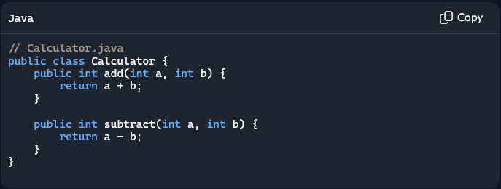
Unit Testing – The simpliest example of a Unit Test
In the code below, we have an example of a simple calculator class, with two methods
Add (Should Add two numbers)
Subtract (Should substract two numbers)
It’s a simple code, right? But what if we invert the + and – signs? No code should be left without unit tests covering it

Slide 45
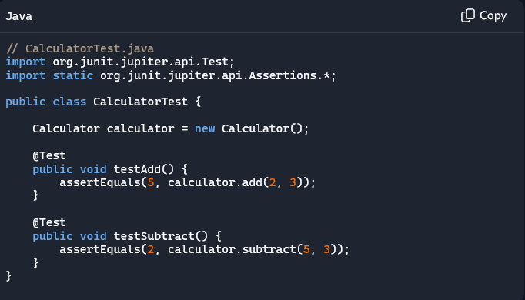
Unit Testing – The simpliest example of a Unit Test
That’s why we create unit tests.
Let’s look add the example of the add method.
We must guarantee that given the inputs (number 1 and 2) we will always have the same output.
On this unit tests we use the inputs 2 and 3 and expect the result to be 5.
If anything happens and the result is not 5, the test should break
So again, given the Input, we should always expect the same output

Slide 46
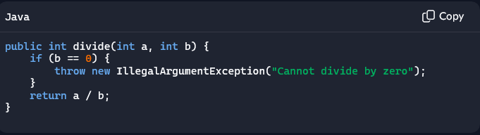
Unit Testing – Taking the example further
The previous add method is very simple and requires only one test.
But what if we have methods that have different behaviors depending on the input?
The code below shows the divide method, which as the name says, divide two numbers, but you can see that this method changes its behavior based on the second number
If b = 0, the output is not the result of the operation, but an exception

Slide 47
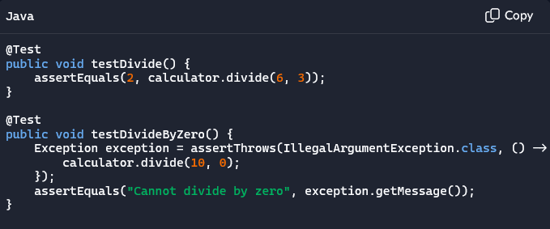
Unit Testing – Taking the example further
Since this case involves two distinct paths, we require two separate test cases to cover each scenario.
This approach ensures that an exception is consistently thrown when the second number is zero,
And likewise guarantees that when the second number is not zero, the division will always produce a result.

Slide 48
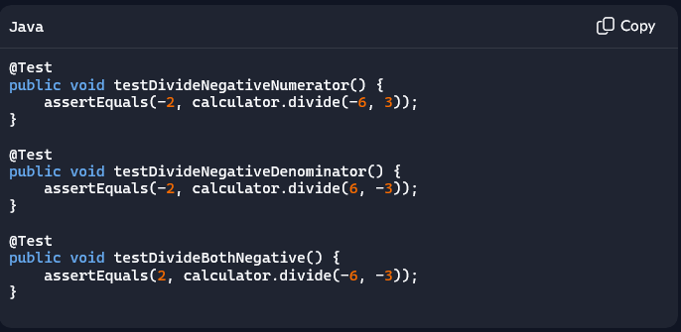
Unit Testing – Taking the example even further
We can also take this even further, what if we want to make sure that the division is working well even if we have negative numbers?
We could create more unit tests with negative numbers and guarantee that the division occurs well.

Slide 49
Unit Testing – Taking the example even further
“So, following this logic, shouldn’t I create a unit test for every possible number combination? To guarantee that every division possible is working correctly?”
We will talk more about it when we discuss about “Overengineering Unit Tests”

Slide 50
What is an input?

Slide 51
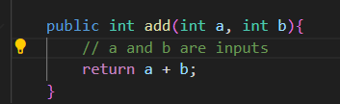
Unit Testing – What is an input
An input refers to any data that enters a method and affects how it functions or what it produces.
A frequent misunderstanding is that input only consists of the parameters passed to a method, but it can include more than that.
Recognizing all the inputs to your method is crucial when designing effective unit tests.
The most common case is parameters.
Any data that enters the method trough parameters is an input

Slide 52
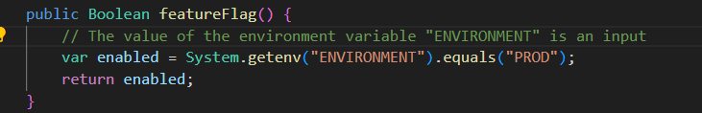
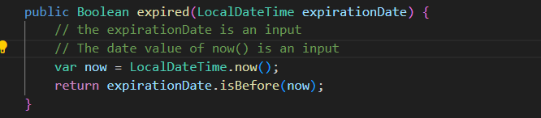
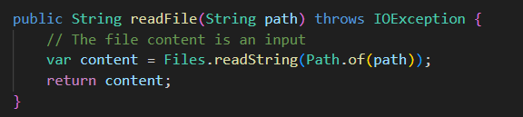
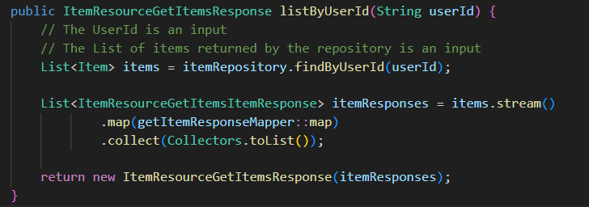
Unit Testing – What is an input
The are cases where your inputs come from running other methods outside of the scope of your function

Slide 53
What is an output?

Slide 54
Unit Testing – What is an output
An output refers to any data that leaves a method.
A frequent misunderstanding is that input only consists of the variable that the method returns (when not void), but it can include more than that.
Recognizing all the outputs to your method is crucial when designing effective unit tests.
The most common case is parameters.
Any data that leaves the method trough parameters is an output

Slide 55
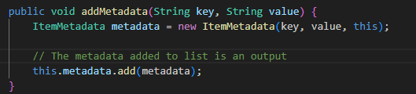
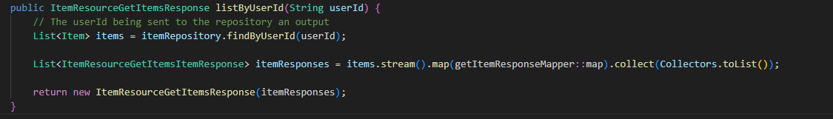
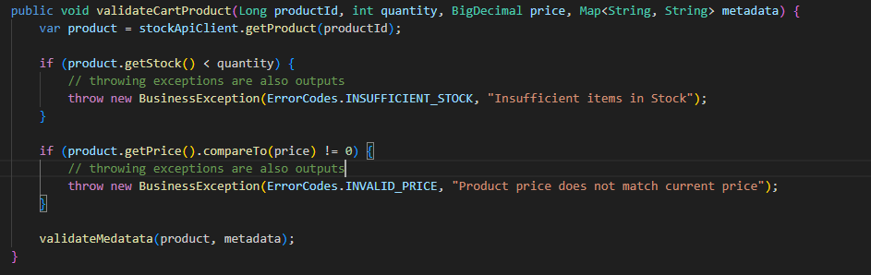
Unit Testing – What is an output
There are cases where your outputs are sent by running other methods outside of the scope of your function

Slide 56
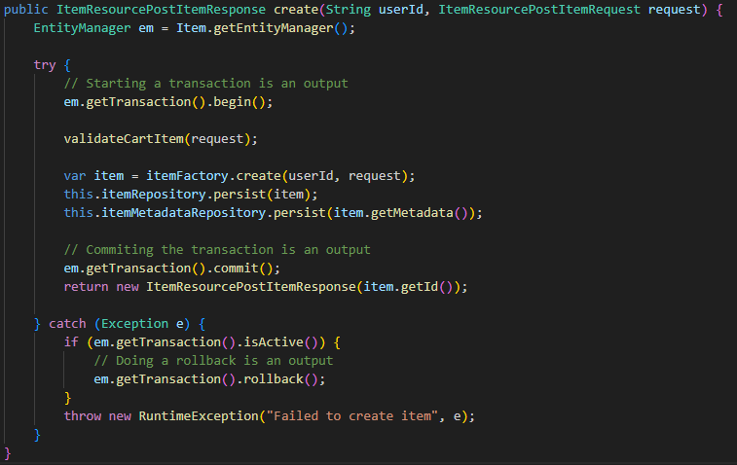
Unit Testing – What is an output
There are cases that even calling a method without any parameters is an output

Slide 57
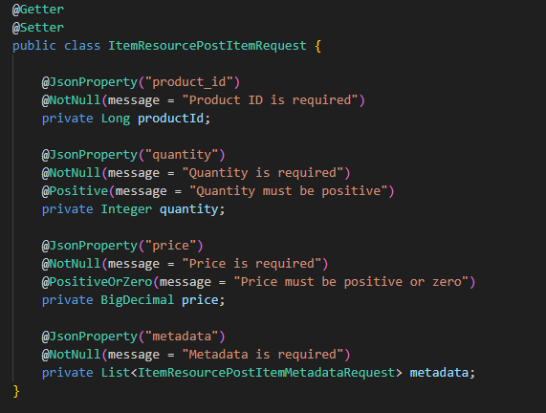
Methods are not the only things that need testing
Typically, Unit Tests are employed to verify the behavior of methods; however, depending on the programming language and its available tools, they can also be used to validate behaviors beyond just methods.
One example of this is the use of annotations in Java.
Consider the example shown on the right.
There are several annotations applied to the variable name for JSON serialization/deserialization, as well as annotations for data validation.
Incorrectly modifying these annotations or their parameters can cause errors in the application, some of which may have significant consequences for the user.

Slide 58
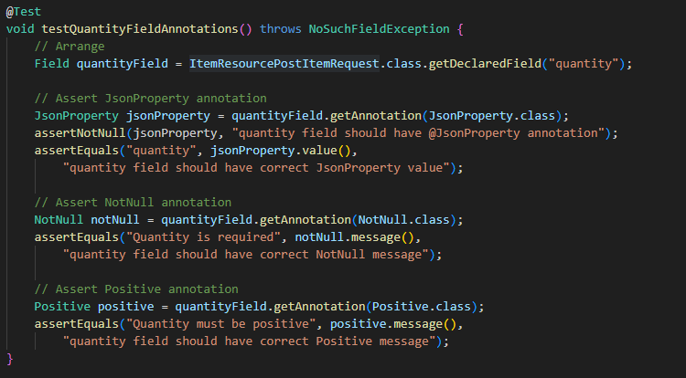
Methods are not the only things that need testing
In this situation, it is essential to have tests that cover these decorators to make sure such errors are detected.

Slide 59
Unit Tests Are FIRST

Slide 60
Fast, Isolated, Repeatable, Self-Verifying, and Timely
F
I
R
S
T
Fast
Isolated
Repeatable
Self-Verifying
Timely
Tests should run quickly so they don’t slow down development or deployment.
Each test should run independently, without relying on external systems like databases or APIs.
Tests should produce the same results every time, no matter where or when they're run.
Tests should automatically check for success or failure—no manual inspection needed
Tests should be written at the right time—ideally during or before the code they’re testing.

Slide 61
TDD – Test Driven Development

Slide 62
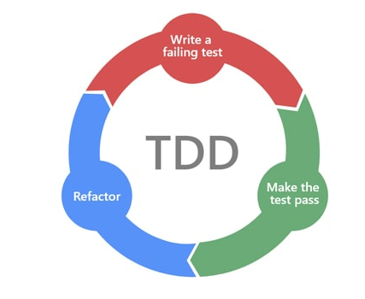
Test Driven Development - TDD
Test-Driven Development (TDD) is a software development approach where developers write automated tests before writing the actual code. The process follows a cycle known as Red-Green-Refactor:
🔴 Red: Write a test that fails (because the feature doesn’t exist yet).
🟢 Green: Write the minimum code needed to make the test pass.
🔁 Refactor: Clean up the code while keeping the test passing.
This method helps ensure code quality, reduces bugs early, and encourages better design decisions. It's like building software with a safety net from the start.

Slide 63
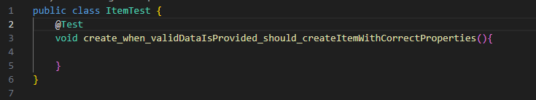
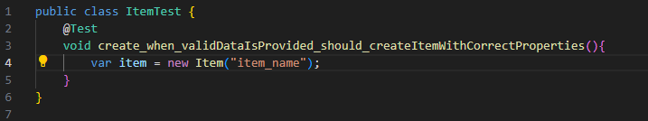
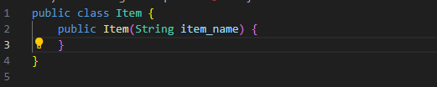
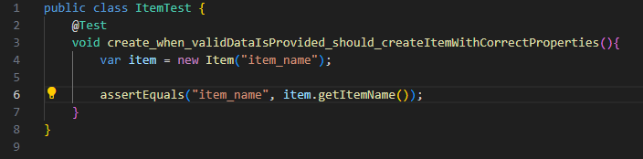
TDD In Practice

Slide 64
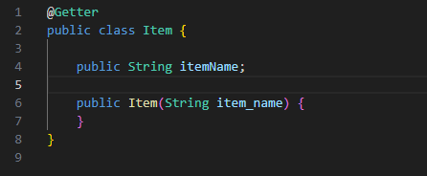
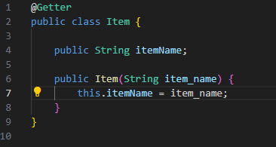
TDD In Practice
Finished

Slide 65
Is Mandatory to use TDD?

Slide 66
TDD Pros and Cons
TDD has pros and cons and is up to the developer to decide to follow or not.
It’s not mandatory to follow the TDD approach to have unit tests in your project.

Slide 67
TDD Pros
Design-Driven Development
Writing tests first forces you to think about design and interfaces before implementation.
High Test Coverage
Each feature begins with a test, ensuring comprehensive coverage.
Immediate Feedback Loop
You catch bugs early, often before the code is even written.
Confidence in Refactoring
Since tests are tightly coupled with design, refactoring becomes safer and easier.
Minimal Code Waste
You only write code to pass tests, reducing unnecessary functionality.

Slide 68
TDD Cons
Slower Initial Development
Writing tests before code can feel slower, especially for simple tasks.
Requires Discipline
Developers must stick to the Red-Green-Refactor cycle, which can be mentally taxing.
Harder for Legacy Code
TDD is difficult to apply retroactively to existing codebases.
Overhead for Small Projects
Might be overkill for quick prototypes or throwaway scripts.

Slide 69
The Scope of a Unit Test

Slide 70
The Scope of a Unit Tests
Unit tests should focus solely on the behavior of the component under test and should not rely on the behavior of methods beyond their own scope.

Slide 71
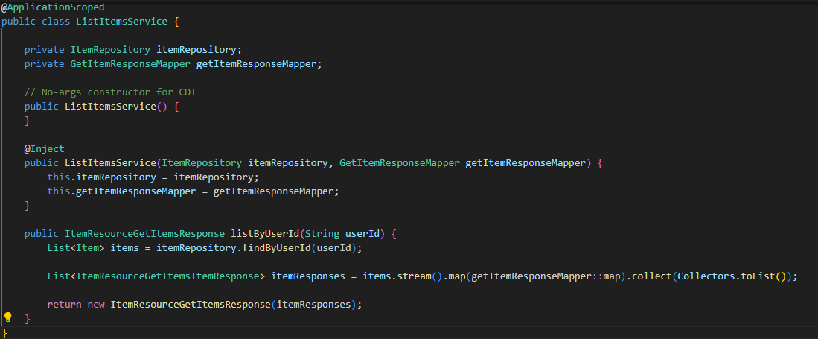
The Scope of a Unit Test - Examples
Let’s look at the example on the right
I have a method that receives a userId, calls the repository to fetch a lista of items for that user and parses de objecto to a response DTO.
My unit tests shouldn’t validate if the query I’m using is right, or if I’m using SQL Server ou MySQL, o even if I use the database at all.
What my unit tests should validate is:
Given a user_id [Input] when I call the repository [Output] and it returns a list of items [Input], I will always have the same DTO being returned by the method [Output].

Slide 72
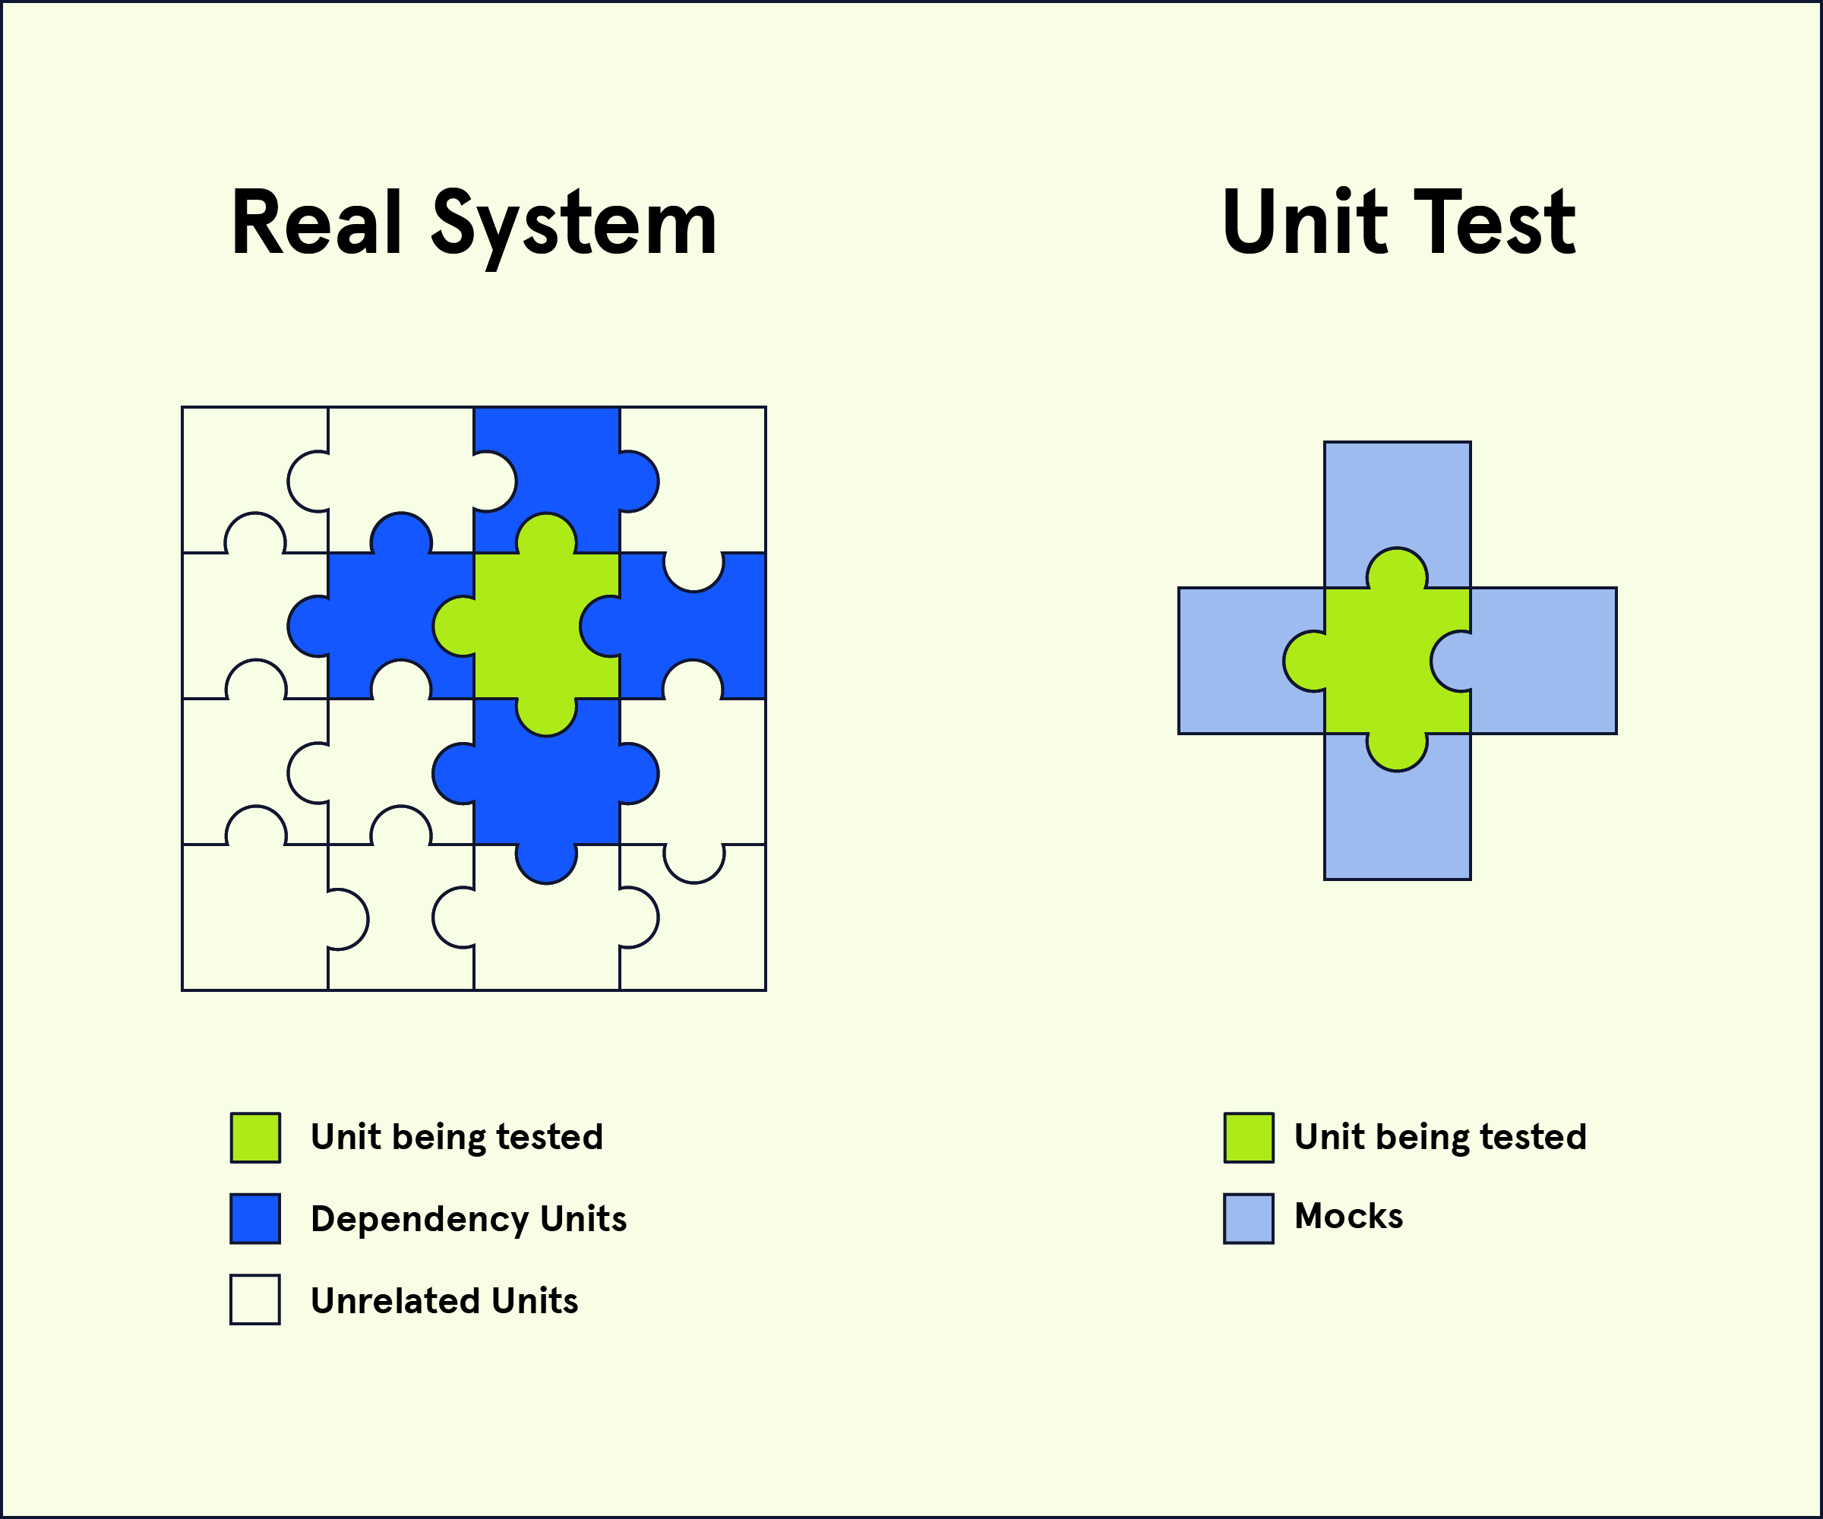
That’s why we should use Mocks
Employing mocks ensures that your unit tests remain unaffected by changes in other classes and methods, as long as their interfaces remain consistent.
In practical applications, mocking plays a crucial role in unit testing and is highly recommended.

Slide 73
Different Programming Languages have different Mocking Libraries
Various programming languages offer distinct mocking libraries, yet many share comparable methods and configurations.
Especially when the syntax of the languages is alike, such as Java and C#, their mocking libraries often use nearly identical code structures.
Java: Mockito, EasyMock, Jmockit
.NET: Moq, Nsubstitute, FakeItEasy
Python: unittest.mock, pytest-mock, mock (PyPI)
Javascript: Jest, Sinon.js, ts-mockito

Slide 74
Mocking in Java Using Mockito
Let's revisit the code we discussed earlier as an example.
Once more, I have a method that takes a userId, queries the repository to retrieve a list of items for that user, and converts the object into a response DTO.
This method, calls two external classes.
1. One for retrieving items from the database
2. One for mapping the domain object to a DTO

Slide 75
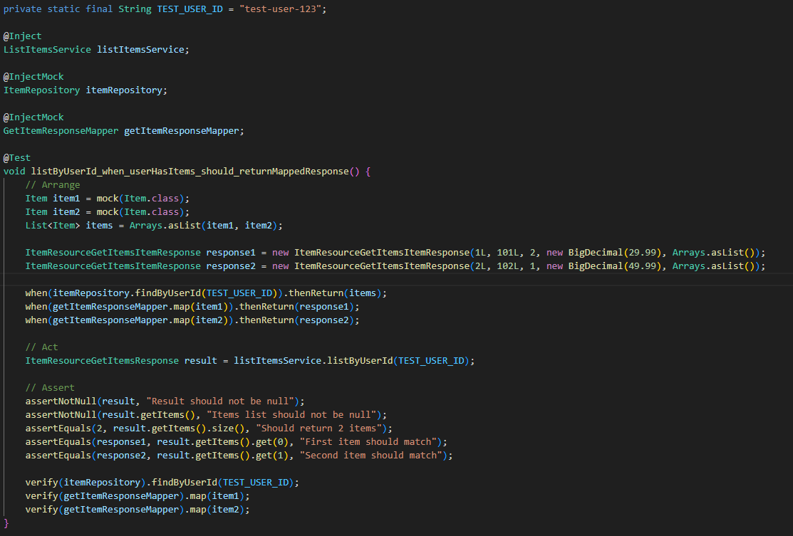
Mocking in Java Using Mockito
For that code, we can have the following unit test.
But let’s break down part by part do understand what this test is doing

Slide 76
Part 1: Arrange

Slide 77
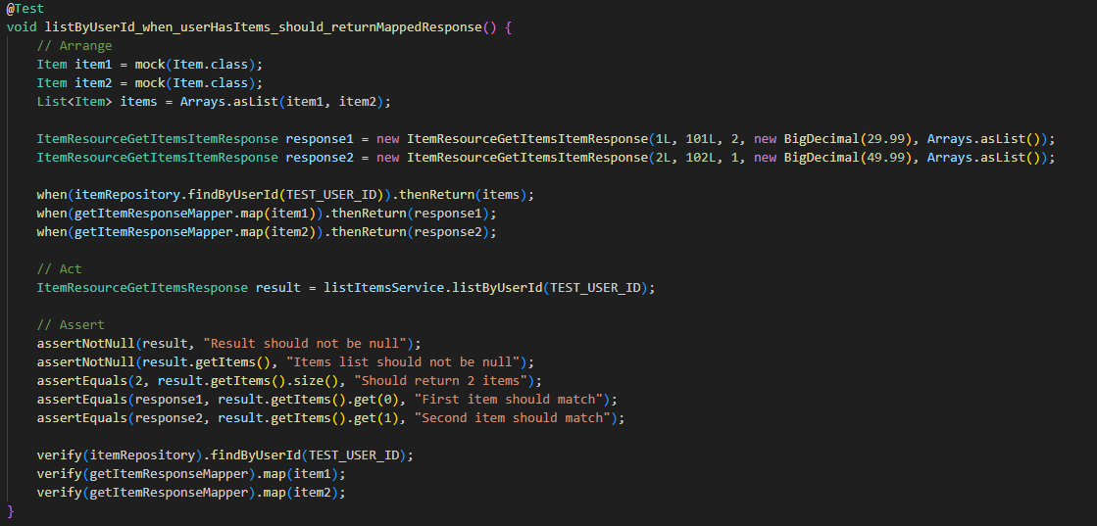
Mocking in Java Using Mockito - Arrange
First, we need to setup the test data we are going to use to create the unit tests
I this case, we need a list of Items, which we will be using to mock the return of the call to the repository.
Also, we need some DTOs, which we will be using to mock the return call to the mapping class.

Slide 78
Mocking in Java Using Mockito - Arrange
Now, we use mockito to mock the calls to the external methods
We mock the ‘itemRepository.findByUserId’ so that every call with TEST_USER_ID results in the list of items I defined in the test
We also mock the calls for the ‘getItemResponseMapper.map’ so that the calls with each of the items, results in the correspond DTO

Slide 79
Part 2: Act

Slide 80
Mocking in Java Using Mockito
In the act stage, we simply run the method we are testing and capture the method result, if it exists

Slide 81
Part 3: Assert

Slide 82
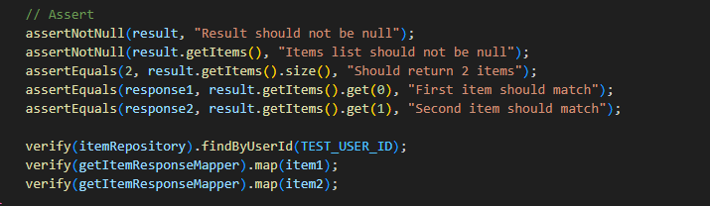
Mocking in Java Using Mockito
Now, we have the most important part, the assertions, where we make sure that we have the expected results given the inputs we defined in the ‘Arrange’ stage
First, we assert the object returned on the method, if we have the items that we expected
Second, we validate if we called the external methods with the right parameters.

Slide 83
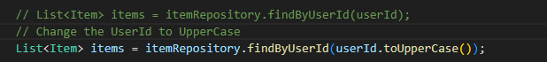
Mocking in Java Using Mockito
Now, we have a unit test covering one scenario of that method.
If we attempt to include some errors, we can see the test breaking
In this case, the test broke because we use the plain userId to setup de mock, not the uppercase of it

Slide 84
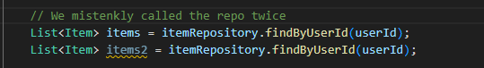
Mocking in Java Using Mockito
Now, we have a unit test covering one scenario of that method.
Another example, we if mistakenly call the repository twice
In this case, the test broke because we verify if the test is being called only once
If calling the repository twice was indeed the expected behavior, we should have added this on the test

Slide 85
Improving our unit test
When writing unit tests without using mocks, your test becomes vulnerable to failures caused by changes in other methods. For example, if the constructor of the DTO you create contains logic—such as requiring the first parameter to be greater than a certain value or the last parameter not to be an empty list—any modification there could cause your test to fail. This would happen even though the internal workings of the DTO don’t matter for the behavior of the method you are testing.
In that case, we could substitute the DTO concrete classes with a mock, this way, a change in the DTO internal behavior would not impact our test.

Slide 86
So, what behavior should I test?

Slide 87
It depends…
Unit Testing are not a totally exact science.
In a perfect world, you would need to test every combination possible, but in the real world with limited time, we should focus on what really matters.

Slide 88
How we divide test cases
We can divide test cases in the following buckets
Common Cases
Middle Cases
Edge Cases
These are the typical inputs your function or module is expected to handle regularly.
These are less typical but still valid inputs—often used to test how your code handles moderately complex or borderline scenarios.
Involves a problem or situation that occurs only outside of normal operating parameters

Slide 89
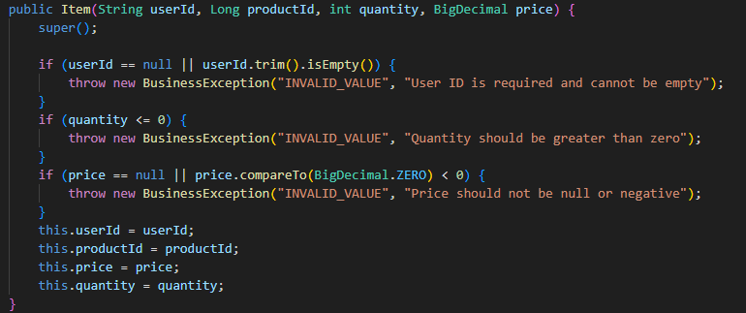
Common, Middle and Edge Cases
To showcase those buckets, let’s look at this code

Slide 90
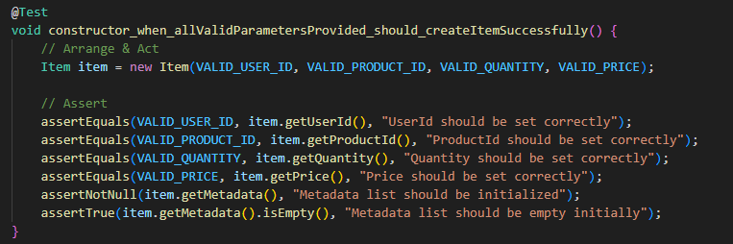
Common Cases
A common test case we could have is to check the happy path, making sure that the most common scenario is validated

Slide 91
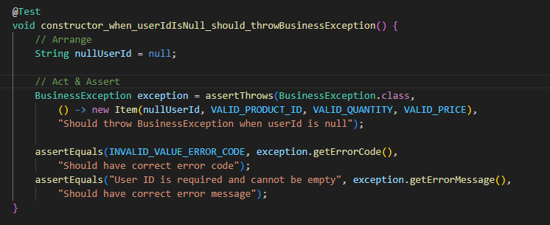
Edge Cases
Whenever we move away from the typical situation, it results in an edge case.
In this example, an edge case might occur when the userId is invalid, and in such a situation, an exception should be thrown and tested for.

Slide 92
Middle Cases
Middle cases are where the unit tests stop being an exact science.
I could have the following additional test cases to cover, like
Different valid userId formats (email-like, alphanumeric, with special characters)
Various valid quantity values (1, 10, 100, 999)
Different valid price ranges (small decimals like 0.01, large amounts like 9999.99)
Different valid productId values
They would be valid, but is worth the time in doing so?

Slide 93
So, what behavior should I test
So, the rule of thumb could be
Common Cases
MUST have Tests
Edge Cases
MUST have Tests
Middle Cases
Valuable, but not mandatory

Slide 94
Unit testing requires a lot of study; But I need to learn it faster Unit testing requires a lot of work; But I need to delivery my software faster

Slide 95

Github Copilot to the rescue

Slide 96

What is GitHub Copilot
GitHub Copilot is your AI-powered coding companion, designed to help developers write code faster and smarter—right inside their favorite IDEs like Visual Studio Code, JetBrains, and Neovim.
Esta Foto de Autor Desconhecido está licenciado em CC BY

Slide 97
How do I start with GitHub Copilot?
All you need is a GitHub account and your IDE of choice.
Copilot currently have a free tier for every user to try

Slide 98
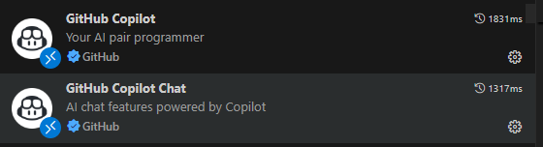
Copilot in VSCode
GitHub Copilot is available in many different IDEs as well as a command line interface and also in the GitHub portal. In our case, we will demonstrate on using Copilot with Visual Studio Code.
First, you need to install de GitHub Copilot Extensions.
A window asking to login to github should appear, if not you can login using the Copilot Chat window

Slide 99
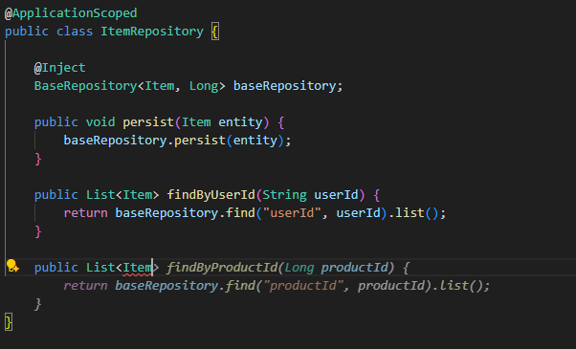

Ways to use Copilot in Your VSCode - Intelisense
Copilot is embedded already in your IntelliSense, as you type in the editor, it will try to infer based on context (all the files open in your editor).
In the example on the right, just by start typing it tried to infer the following text. As you type, it will recalculate and try to guess what you are trying to do.
Also, Just by typing comments and hitting enter, copilot will try to implement the method for you.
In both cases, you can hit tab to accept the suggestion or ctrl + right arrow to go the next suggestion

Slide 100

Ways to use Copilot in Your VSCode – Inline Chat
Another way to use GitHub Copilot is using the inline chat.
By hitting ctrl+I, a small window opens, where you can type your prompt and check the suggestions.
GitHub copilot uses some information as the context to try to generate text, such as:
1. The code you have selected
2. The current open file
3. All the files open in your editor

Slide 101

Ways to use Copilot in Your VSCode – Copilot Chat
The most common method, offering the greatest flexibility, is Copilot Chat.
By pressing ctrl+alt+I, you open the Copilot Chat panel on the right side, where you can enter prompts, ask questions, or generate code.
Copilot maintains the context of the conversation, allowing for an ongoing dialogue without needing to rely on individual prompts.
Additionally, you can manually provide context such as other files, and you have the option to undo changes made by Copilot on a per-change basis.

Slide 102
Copilot Chat Modes
In Copilot Chat, you have 3 different modes:
Ask
Edit
Agent

Slide 103

Ask Mode
Ask mode is useful for obtaining quick answers and insights without having Copilot modify your code.
You can ask about your code or any question around development, such as how to use a library, how do an algorithm or ask to it to analyze an error message
​

Slide 104

Edit Mode
In the edit mode, copilot you try to change your current file based in your prompt.
Is recommended for cases where your need to create modifications in a single file
​

Slide 105

Agent Mode
In the agent mode, Copilot can navigate your entire project, make multi-file changes, run commands, and help with setup or debugging.
Agent Mode in GitHub Copilot is recommended when you're tackling complex, multi-step tasks that go beyond simple code suggestions.
​

Slide 106


Changing Models and Add Context
On the Copilot Chat Screen, you have the option to switch the LLM employed by GitHub Copilot and manually include files to provide additional context.
It's recommended to experiment with different LLM models to determine which one suits your needs best.

Slide 107
Using Copilot to Generate Unit Tests

Slide 108

Using Copilot for Unit Tests
To use copilot to generate unit tests is as simple as selecting the file or code you want to test and send the prompt: “Create Unit tests for this”

Slide 109
Using Copilot for Unit Tests
Although Copilot generated a unit test, there is room to enhance its readability.
For example, by clearly dividing the Arrange, Act, and Assert phases, avoiding the use of internal classes, and improving the naming conventions of test methods, the tests can become easier to understand and maintain.
Let’s first focus on avoiding using internal classes.

Slide 110

Using Copilot for Unit Tests
Requesting to avoid internal classes resulted in multiple files being generated, which was not quite what we anticipated; we expected all test cases to be contained within a single class. Therefore, we need to submit another prompt.

Slide 111
Using Copilot for Unit Tests
We have now resolved this particular issue and improved our unit test slightly.
However, there are still other problems, which raises the question:
Do I need to continuously interact with and guide Copilot for every new test I create to prevent errors?
Not necessarily. To address this, we can develop custom prompt files that provide Copilot with instructions from the outset, ensuring it consistently adheres to our project’s guidelines.

Slide 112

Using Copilot for Unit Tests
Initially, we prepare our prompt file containing the necessary instructions.
​Next, prior to submitting the prompt, we use the Add Context button to include this prompt file and send it to Copilot along with our prompt.

Slide 113
Prompt Engineering

Slide 114
Prompt Engineering
One of the vital parts of using LLMs is prompt engineering.
Prompt engineering is about:
Clarity: Making your intent obvious to the model
Specificity: Avoiding vague or overly broad instructions
Structure: Using formatting, examples, or constraints to guide the output
Iteration: Refining prompts based on results to improve performance
Prompt engineering requires study and is challenging at first, but the good part is that you can use LLMs to generate prompts to use the LLM again. This strategy is called Prompt Bootstrapping

Slide 115

Prompt Engineering
Let’s go back to our previous example, but instead of writing the reusable prompt, let’s ask for the copilot itself to write for us
Requesting Copilot to create the prompt results in a higher-quality prompt that adheres to several key principles of effective prompt engineering.

Slide 116
Prompt Engineering
As the project advances and we refine our instructions for creating unit tests, the results will steadily improve.
​
Furthermore, these prompts can be distributed across different projects or shared with team members to speed up test automation across the organisation and broader community.
​
In addition, Prompt Bootstrapping simplifies the process of developing effective prompts, even for those with limited training.

Slide 117

Prompt Engineering
Below, we can see unit tests generated with a full set of instructions refined over time, we can see that we have much cleaner tests that follow our project guidelines.

Slide 118
Cool, now that Copilot created the tests for me, I just have to commit and…

Slide 119
No, you should ALWAYS review every piece of code that GitHub Copilot generates
Although Copilot demonstrates impressive intelligence, it may not fully grasp the complete context of your project, security needs, or uncommon scenarios.
Copilot can generate code that is syntactically accurate but functionally incorrect, potentially introduce security weaknesses, or overlook best practices, particularly in intricate systems.
Having a human review the code is essential to ensure it is secure, efficient, and matches your goals. Consider Copilot as a valuable helper rather than the ultimate decision-maker.

Slide 120


Slide 121
Cool, now that I have unit tests, my software will always work as expected

Slide 122



But no

Slide 123
Integration Testing

Slide 124
Integration Tests
Integration tests are a type of software testing that focuses on verifying how different components or modules of an application work together as a whole.
Unit Tests
Integration Tests
Ensure that units work in isolation
Ensure that units work together

Slide 125
Unit Tests vs Integration Tests
Integration Tests
Unit Tests

Slide 126
But my components running together is what matters… Why should I create unit tests when integration tests do the job?

Slide 127
Why shouldn’t I do only integration tests?
You’re correct that the aim is for components to function together.
However, depending solely on integration tests is comparable to seeing if the entire car runs without examining the engine, brakes, or steering separately.
​
If the car breaks down, how do you determine the problem?

Slide 128
Unit Tests vs Integration Tests
Unit Tests Integration Tests
Faster
Simpler
Cheaper
Easy to maintain
Do not validate if the system works
Do not validate System Behavior
Slower
Complex
Expensive
Difficult do maintain
Validate if the system works
Validate System Behavior
“this part works.”
“this part works with everything else.”

Slide 129
Anatomy of am Integration Test
The anatomy of an integration test is the same of the unit test.
Input
Process
Output
Given one Input, after the Processing you should get the same Output.

Slide 130
Integration Test Isolation

Slide 131
Should my integration tests depend on external services?
The point of integration testing, as the name suggests, is to test whether many separately developed modules work together as expected.
Commonly, this includes external modules, such as APIs, Databases and other external services.
Integration Tests should make sure that the application you’re testing is working with those external services

Slide 132
Integration Tests Isolation
But using testing against those external services can be challenging.
Let’s create a use case to demonstrate how testing external services can be challenging.

Slide 133
Fabrikam Bank Case – Money Transfer

Slide 134
Fabrikam Bank Case – Money Transfer
As a developer at Fabrikam Bank working in the Transfer Module, your responsibility is to design an integration test for the money transfer process that involves interaction with several external services.
The flow of data follows the example in the next slide

Slide 135


Fabrikam Bank Case – Money Transfer
Balance Module DB
Account Module
Return user balance
Secures the user's balance
Decrease the user's balance
Transfer Module
Receives the request of the user
Calls the User Service to verify user transfer limits
Calls the Account Module to check if the user has money available
Calls the Central Bank to verify if the target account exists
Calls the Fraud Detection Provider
Calls Account Module to Secure user Balance
Calls the Target Bank to Register the transfer
Calls the Account Module to decrease the user's balance.
User Module
Central Bank
Fraud Detection Provider
Target Bank System
Return user info
Return target user information
Check for Fraud
Register Transfer
User
Module DB
?
?
?
?
?
?
?
?
?

Slide 136
Fabrikam Bank Case – Money Transfer
In this situation, where numerous external services are involved, how can we develop an integration test to verify that our Transfer Module functions correctly?
We would have to set up our data (inputs) across many external services, many of which we do not control.
Additionally, various problems could arise that would demand significant effort to configure and might even incur financial costs.

Slide 137
Fabrikam Bank Case – Money Transfer
Balance Module DB
Account Module
Will we have network connection between those services?
Return user balance
Secures the user's balance
Decrease the user's balance
How much time do will I need to do all the setup?
Will I need knowledge of the external services internal behaviour?
How often we can run those tests? Do we need to schedule?
Transfer Module
Receives the request of the user
How much time will take for those tests to run?
Calls the Account Module to decrease the user's balance.
Calls the User Service to verify user transfer limits
Calls the Account Module to check if the user has money available
Calls the Central Bank to verify if the target account exists
Calls the Fraud Detection Provider
Calls Account Module to Secure user Balance
Calls the Target Bank to Register the transfer
Do I need to use real user data to run those tests?
Can this test impact production?
Can I change in another module break my test?
User Module
Central Bank
Fraud Detection Provider
Target Bank System
Return user info
Return target user information
Check for Fraud
Register Transfer
Will those modules always be online?
Will we have the required inputs in all the services?
How much is going to cost calling those external services?
User
Module DB
?
?
?
?
?
?
?
?
?

Slide 138
Creating integration tests with External Services is challenging and, in some cases, even not possible. So, do I have another choice?

Slide 139
Narrow Integration Tests

Slide 140
Broad Integration Tests vs Narrow Integration Tests
Historically, Every Integration Tests would use actual external services, which can cause the issues we discussed before, but there’s where Narrow Integration Tests come in.
Narrow Integration Tests follows the same objective of Broad Integration Tests, with the exception that every external service is substitute by a Mock.

Slide 141

Narrow Integration Tests vs Broad Integration Tests

Slide 142
Narrow Integration Tests vs Broad Integration Tests
Narrow Integration Tests
Narrow Integration Tests
Fast and reliable Fewer moving parts mean quicker execution and fewer flaky tests.
Easier debugging Failures are localized, making root cause analysis much simpler. Isolated dependencies
You can use test doubles (mocks/stubs) to simulate external systems, reducing setup complexity.
Better coverage of edge cases
You can test specific interaction paths without needing the whole system. Limited realism Doesn’t fully replicate how components behave in the real system. False confidence Just because two modules work together in isolation doesn’t mean they’ll behave correctly in the full system.
High realism
Tests run in an environment closer to production, catching issues that narrow tests miss.
End-to-end confidence
Validates that the system works as a whole, including data flow and side effects.
Slower and more brittle More dependencies mean longer runtimes and higher chances of flaky tests.
Harder to debug
Failures can be caused by any component, making diagnosis more complex.
Complex setup
Requires full environments, databases, services, etc., which can be hard to maintain.

Slide 143

If your only integration tests are broad ones, you should consider exploring the narrow style, as it's likely to significantly improve your testing speed, ease of use, and resiliency.
Martin Fowler
https://martinfowler.com/bliki/IntegrationTest.html

Slide 144
What Tools should I use to create an integration testing?

Slide 145
Integration Test Tools
Integration Tests are not limited to specific tools; you can utilize the same libraries employed for Unit Tests, for instance.
Alternatively, you might consider adopting the Behavior Driven Development methodology.

Slide 146
What is BDD

Slide 147
What is BDD?
Behavior-Driven Development (BDD) is a software development approach that focuses on collaboration between developers, testers, and business stakeholders to define how a system should behave—before writing the code.
It’s a refinement of Test-Driven Development (TDD), but instead of writing low-level unit tests first, BDD starts with high-level, human-readable scenarios that describe the desired behavior of the system in plain language.

Slide 148
How BDD Works
BDD uses a structured format like Gherkin syntax, which looks like this:
Feature: Login functionality
Scenario: Successful login
Given the user is on the login page
When they enter valid credentials
Then they should be redirected to the dashboard
These scenarios are:
Written in natural language so everyone can understand them
Used as living documentation that evolves with the system
Automatically linked to automated tests that validate the behavior

Slide 149
Why use BDD
Shared understanding:
Everyone—devs, QA, product owners—gets on the same page.
Better communication:
Requirements are expressed as examples, not abstract rules.
Faster feedback:
You catch misunderstandings early, before code is written.
Improved test coverage:
Scenarios reflect real user behavior, not just edge cases

Slide 150
When should I start doing BDD?
BDD starts in the requirements gathering phase.
​
It proves most valuable when defining user stories and clarifying the system’s intended behaviour.
​
It facilitates alignment among developers, testers, and stakeholders by establishing common expectations.

Slide 151
What Tools can I use to start doing BDD
Depending on your tech stack, you might use: - Cucumber (Java, JavaScript, Ruby)
- SpecFlow (.NET)
- Behave (Python)
- Karate (API testing with BDD-style DSL)

Slide 152

How BDD Works
As previously noted, BDD is expressed in natural language to describe the application's behavior. However, this needs to be converted into code to execute our tests.
To illustrate this process, we will use Cucumber, a tool for implementing BDD that supports multiple programming languages.
Cucumber uses the Gerkhin Language
syntax
https://cucumber.io/

Slide 153
Creating a Narrow Integration Test using Cucumber

Slide 154
Creating a Narrow Integration Test using Cucumber
On our Integration Test, we will use the Narrow approach. Using Mocks for any connection to external services.
Our demo application is a simple Ecommerce Cart Module and we will write tests for the Add Item to Cart Feature
Cart Module
Receives the Item Information in the /items endpoint
Obtains the product stock information from the Stock Module
In the product is in stock and has the price matches, insert in the database
Stock Module
Cart Module Database
Returns the Product Information

Slide 155

Using BDD – Creating your Test Definition
To begin, we must develop our feature file, using natural language to outline our test case.

Slide 156
Using BDD – Creating your Test Definition
On the file, we can see a few of the Gherkin Language keywords
Feature Describes the high-level functionality or capability being tested.
Background
Sets up common context or preconditions shared by all scenarios in the feature.
Scenario
Represents a specific example or test case of how the feature should behave
Given
Defines the initial state or setup before the action occurs. (Similar to the Arrange Phase of Unit Tests)
When
Specifies the action or event triggered by the user or system. (Similar to the Act Phase of Unit Tests)
Then
Describes the expected outcome or result after the action. (Similar to the Assert Phase of the Unit Tests)

Slide 157


Using BDD – Creating your Step Definitions – Step 1
Now, lets create the code that our test will run in each of the steps, starting from the first given step
The test runner searches for a function whose annotation (given, then, or when) corresponds to the text described in the feature file and executes it.
In this example, we simply generate a “valid-user-id” and save it for later use.
As this Step is defined in the Background, It will run for every scenario we defined in this file

Slide 158

Using BDD – Creating your Step Definitions – Step 2
Now, to the first step of our test scenario
As we are following the Narrow Approach, at this stage, we simulate the Stock API call by providing a response that returns a valid product.

Slide 159


Using BDD – Creating your Step Definitions – Step 3
At this stage, we submit the request to our application, simulating the transmission of a valid item.
After that, we save the response for later use.

Slide 160
Using BDD – Creating your Step Definitions – Step 3
At this stage, we submit the request to our application, simulating the transmission of a valid item.
After that, we save the response for later use.

Slide 161


Using BDD – Creating your Step Definitions – Step 4
On this step we validate if the response we got from the API was successful (Status Code 200)

Slide 162


Using BDD – Creating your Step Definitions – Step 5
Then, we validate if the item that we added to the cart was added to the database with the right information

Slide 163


Using BDD – Creating your Step Definitions – Step 6
In the final step, we verify whether the ID provided by the API corresponds to the ID stored in the database.

Slide 164
Checking the Test Results

Slide 165

Cucumber Test Report
After executing the BDD Test, you can check the results directly on the console. You will get the result for each of the steps and also a summary of all the test scenarios

Slide 166

Cucumber Test Report
It is also possible to create an HTML Report that displays details for every test scenario and step.
Additionally, you have the option to filter results by text or tags.

Slide 167

Cucumber Test Report
Results can be exported to a JSON file, allowing you to build custom handlers tailored to your specific needs.

Slide 168
Step Parameters

Slide 169

Step Parameters
When writing tests, you may reach a point where the same action needs to be performed with different input values. In such cases, step parameters are useful—they allow you to define the step just once, while customizing its behavior through different values specified in the feature file

Slide 170

Step Parameters
Now we can cover two scenarios and reuse 3 steps, allowing us to scale and avoid duplicated code

Slide 171

Step Parameters
We can also have parameters as a table
Or a huge amount of text

Slide 172
What kind of wording should I use in my feature files?

Slide 173

How should I write my feature files
There’s no single correct approach to writing feature files—you can keep them simple and non-technical, or dive into a highly technical style. Let’s explore a few examples.
On the example below, we use a nontechnical vocabulary, which can be easier to read, but can lead to some information to be unclear.
Like:
“What is the definition of a valid product?”
“What is exactly the action to add product to the cart?”

Slide 174
How should I write my feature files
We can go further and add more technical details to our feature definition.
Like what values we are using for each one of the actions.
This can lead to more clear instructions for the technical folk and favor reuse of steps.
But can be challenging to read by people who are not used to the code base.

Slide 175

How should I write my feature files
And finally, we can get fully technical.
This way the instructions are clear and we it’s much easier to reuse steps.
But this makes more difficult to read the scenario case as we have much more text to read and can also be confusing for people who are not used to the code base or that are not technical

Slide 176
Who Should write the integration tests?

Slide 177
Who should write integration tests?
“Ideally: both. Writing integration tests should be a shared responsibility between testers and developers.”
Integration tests should be a join effort between QAs and developers, and who perform each task depends on how the teams are organized.
Developers have more knowledge of how the implementation was done and how can they create the tests.
Meanwhile, QAs have a better understanding of what are the expected behavior of the system from the user perspective.

Slide 178


Who should write integration tests with BDD?
One of the possible development flow when using BDD can be the following:
QA
Writes the Scenarios in Natural Language
Developer
Develop the code that supports each of the outlined scenarios

Slide 179
Using GitHub Copilot in your Integration Tests

Slide 180
Can Copilot create the integration tests from scratch for me?

Slide 181
Can Copilot create the integration tests from scratch for me?
Unlike Unit Tests, which are generally uniform, technology-independent, and narrowly focused, Integration Tests vary significantly depending on the resources involved and the structure of your project.
For example, consider a scenario where your application relies on a database. You have several options for testing:
Use an in-memory database
Mock the database interactions
Connect to a dedicated test database
Each approach has its trade-offs, and choosing the right one depends on your goals and implementation strategy.

Slide 182
Can Copilot create the integration tests from scratch for me?
This type of decision-making also applies to other external dependencies—like APIs, authentication mechanisms, message queues, and beyond.
Each integration point introduces unique challenges when it comes to accurately simulating or mimicking real-world behavior in a testing environment.
Because every project relies on its own set of external systems and architectural patterns, it's extremely difficult to design a single prompt that can be universally applied across multiple projects from the ground up.

Slide 183
So, what could be my strategy to accelerate the creation of integration tests

Slide 184
Accelerating Integration Tests Development
One way to accelerate your integration tests is to start writing your integration tests by your own or with the assistance of GitHub Copilot.
After the few tests are created, GitHub Copilot will have samples of how to implement new integration tests, and the result will improve over time.

Slide 185
Using GitHub Copilot to Create Integration Tests

Slide 186
Using GitHub Copilot to create Integration Tests
As mentioned before, the more tests you have, the better the results of GitHub Copilot on helping to create new ones.
Let’s look at the case were we already have a test scenario and the steps implemented for it.

Slide 187

Using GitHub Copilot to create Integration Tests
After sending the prompt “Implement the integration test for the case when the price of the product being added to the cart don't match”, Copilot created a valid test scenario, reusing existing Steps, which ran just fine and cover the expected test case.

Slide 188

Using GitHub Copilot to create Integration Tests
In the previous integration tests, we were checking the requests for authenticated user, let’s create a test for asserting the behavior when the user is not authenticated “Implement the integration tests scenario, for when the user try to send the request unauthenticated”

Slide 189

Using GitHub Copilot to create Integration Tests
The test ran just fine and the scenario was covered, but we can see that in this case we need to implement new steps to cover this scenario.
In the new step created, we could even make some changes to reuse an existing step instead of creating a new one.

Slide 190

Using GitHub Copilot to create Integration Tests
Now, let’s ask copilot to create tests for the get items feature, which we have no tests so far, by using the prompt “Create an integration tests for getting the user items of the cart”

Slide 191
Using GitHub Copilot to create Integration Tests
We can see that copilot generated valid test scenarios and even implemented the steps, but the tests are failing.
In this case, they’re failing because we are using the same user to run multiple tests and are not cleaning the database before each test. So instead of finding just the expected items, it finds all the items from the tests ran before, making one of the assertions fail
In our add item test, we didn’t have to adapt to this kind of scenario, as we only testing adding items.

Slide 192
Using GitHub Copilot to create Integration Tests
GitHub Copilot isn’t yet equipped to handle this scenario automatically, so manual intervention is required to correct the behavior.
This highlights a broader challenge: Copilot struggles to generate new tests from scratch when there are no existing examples to reference—especially given the complexity of integration tests.
In essence, the more integration tests your application already has, the better Copilot performs. But when you attempt to create something entirely new without prior examples, the likelihood of success drops significantly.

Slide 193
Other examples of using GitHub Copilot in integration tests

Slide 194




Find new test scenarios
You can use copilot to analyze your tests and your code and try to find behaviors that are not covered by any integration tests

Slide 195

Checking if a specific scenario is covered

Slide 196
End to End Tests

